Slide 1
Software Engineering
Dr. Md. Nasim Adnan

Slide 2
A Generic Process Model
As I discussed in Chapter 1, a generic process framework for software engineering defines five framework activities—communication, planning, modeling, construction, and deployment.
In addition, a set of umbrella activities—project tracking and control, risk management, quality assurance, configuration management, technical reviews, and others—are applied throughout the process.

Slide 3
You should note that one important aspect of the software process has not yet been discussed.
This aspect—called process flow—describes how the framework activities are organized with respect to sequence and time and is illustrated in the next figure.

Slide 4
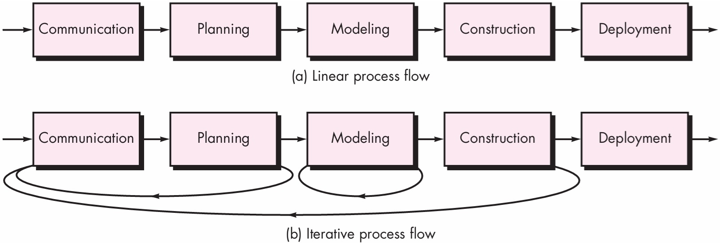

Slide 5
A linear process flow executes each of the five framework activities in sequence, beginning with communication and culminating with deployment (Figure a).
An iterative process flow repeats one or more of the activities before proceeding to the next (Figure b).
An evolutionary process flow executes the activities in a “circular” manner. Each circuit through the five activities leads to a more complete version of the software (Figure c).
A parallel process flow (Figure d) executes one or more activities in parallel with other activities (e.g., modeling for one aspect of the software might be executed in parallel with construction of another aspect of the software).

Slide 6
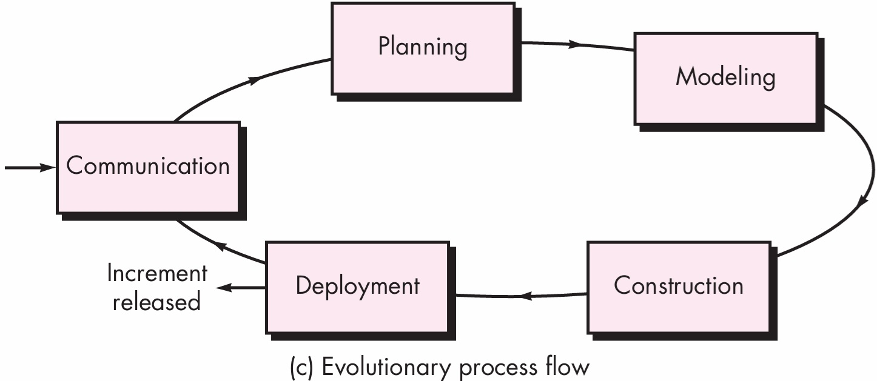

Slide 7
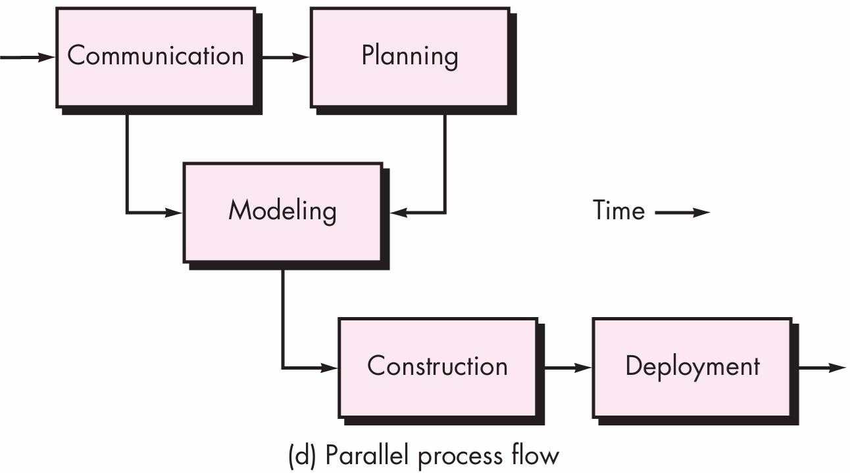

Slide 8
Perspective Process Models
Prescriptive process models were originally proposed to bring order to the chaos of software development.
History has indicated that these traditional models have brought a certain amount of useful structure to software engineering work and have provided a reasonably effective road map for software teams.

Slide 9
The Waterfall Model
There are times when the requirements for a problem are well understood—when work flows from communication through deployment in a reasonably linear fashion.
This situation is sometimes encountered when well-defined adaptations or enhancements to an existing system must be made (e.g., an adaptation to accounting software that has been mandated because of changes to government regulations).
It may also occur in a limited number of new development efforts, but only when requirements are well defined and reasonably stable.

Slide 10
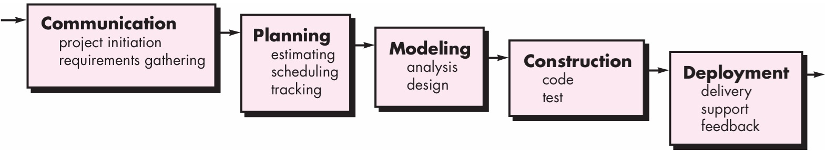

Slide 11
A variation in the representation of the waterfall model is called the V-model.
Represented in next figure, the V-model depicts the relationship of quality assurance actions to the actions associated with communication, modeling, and early construction activities.

Slide 12
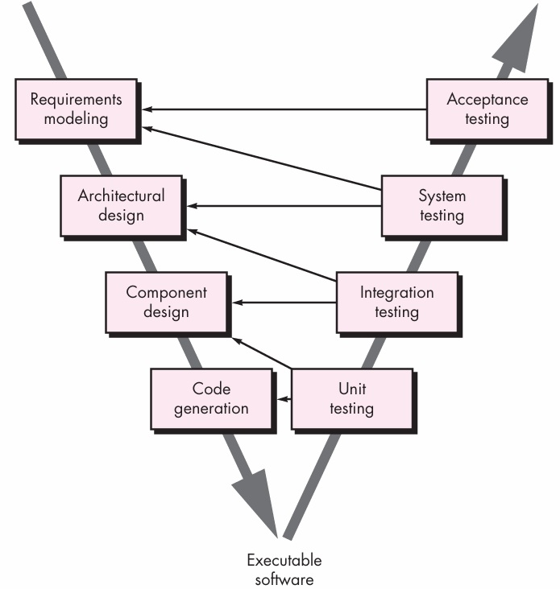

Slide 13
As a software team moves down the left side of the V, basic problem requirements are refined into progressively more detailed technical representations of the problem and its solution.
Once code has been generated, the team moves up the right side of the V, essentially performing a series of tests (quality assurance actions) that validate each of the models created as the team moved down the left side.
In reality, there is no fundamental difference between the classic life cycle and the V-model. The V-model provides a way of visualizing how verification and validation actions are applied to earlier engineering work.

Slide 14
Incremental Process Models
There may be a compelling need to provide a limited set of software functionality to users quickly and then refine and expand on that functionality in later software releases.
In such cases, you can choose a process model that is designed to produce the software in increments.
The incremental model applies linear sequences in an independent fashion as calendar time progresses and each linear sequence produces deliverable “increments” of the software.

Slide 15
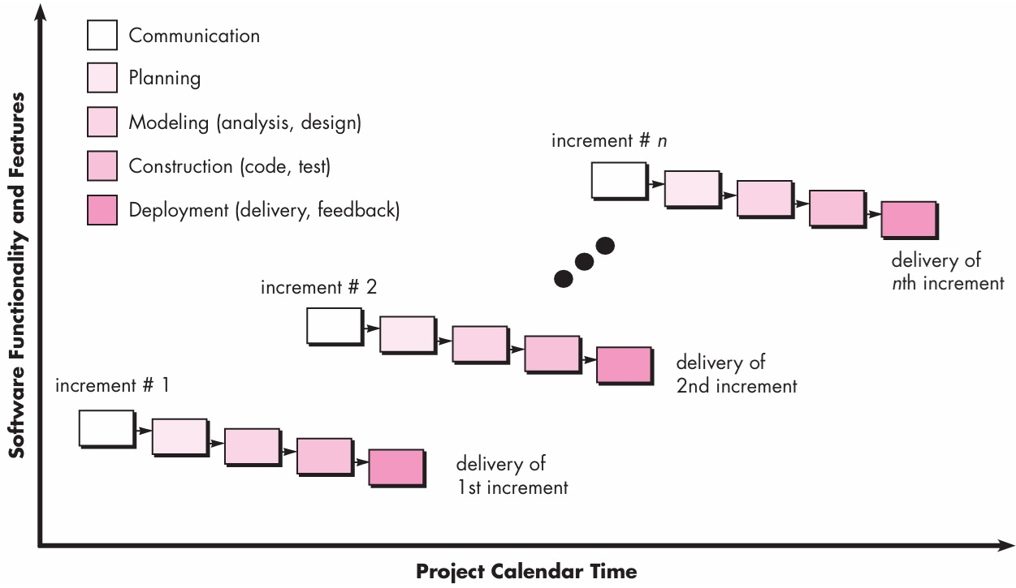

Slide 16
When an incremental model is used, the first increment is often a core product.
That is, basic requirements are addressed but many supplementary features (some known, others unknown) remain undelivered. The core product is used by the customer (or undergoes detailed evaluation).
As a result of use and/or evaluation, a plan is developed for the next increment.
The plan addresses the modification of the core product to better meet the needs of the customer and the delivery of additional features and functionality.
This process is repeated following the delivery of each increment, until the complete product is produced.

Slide 17
Early increments are stripped-down versions of the final product, but they do provide capability that serves the user and also provide a platform for evaluation by the user.
Incremental development is particularly useful when staffing is unavailable for a complete implementation by the business deadline that has been established for the project.
Early increments can be implemented with fewer people. If the core product is well received, then additional staff (if required) can be added to implement the next increment.

Slide 18
Evolutionary Process Models
Software, like all complex systems, evolves over a period of time.
Business and product requirements often change as development proceeds, making a straight line path to an end product unrealistic; tight market deadlines make completion of a comprehensive software product impossible, but a limited version must be introduced to meet competitive or business pressure; a set of core product or system requirements is well understood, but the details of product or system extensions have yet to be defined. (Bonus product)

Slide 19
Evolutionary models are iterative. They are characterized in a manner that enables you to develop increasingly more complete versions of the software.
In the paragraphs that follow, I present two common evolutionary process models.

Slide 20
Prototyping
Often, a customer defines a set of general objectives for software, but does not identify detailed requirements for functions and features.
The prototyping paradigm (next Figure) begins with communication.
You meet with other stakeholders to define the overall objectives for the software, identify whatever requirements are known, and outline areas where further definition is mandatory.
A prototyping iteration is planned and modeling (in the form of a “quick design”) occurs.

Slide 21
The quick design leads to the construction of a prototype.
The prototype is deployed and evaluated by stakeholders, who provide feedback that is used to further refine requirements.
Iteration occurs as the prototype is tuned to satisfy the needs of various stakeholders, while at the same time enabling you to better understand what needs to be done.

Slide 22
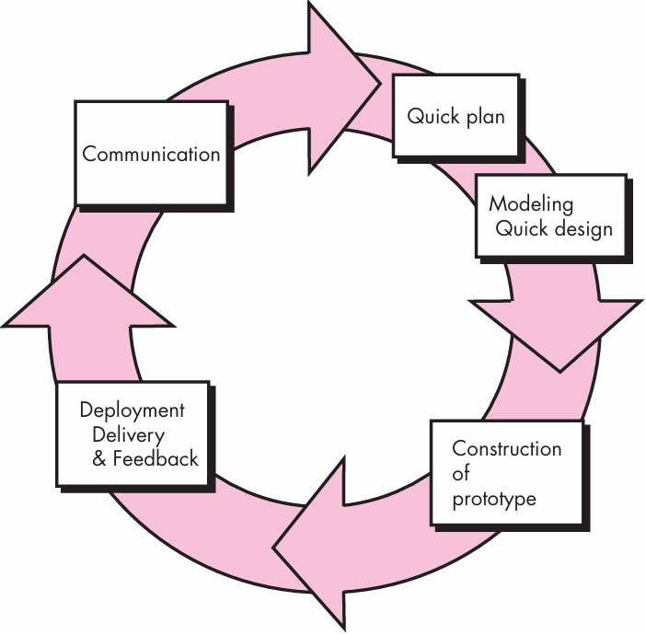

Slide 23
The Spiral Model
Originally proposed by Barry Boehm, the spiral model is an evolutionary software process model that couples the iterative nature of prototyping with the controlled and systematic aspects of the waterfall model.
It provides the potential for rapid development of increasingly more complete versions of the software.

Slide 24
Using the spiral model, software is developed in a series of evolutionary releases. During early iterations, the release might be a model or prototype.
During later iterations, increasingly more complete versions of the engineered system are produced.

Slide 25
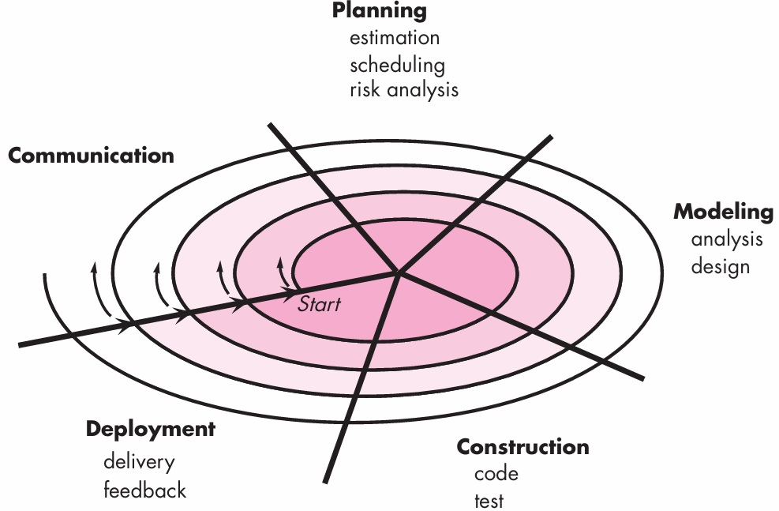

Slide 26
Concurrent Models
The concurrent development model, sometimes called concurrent engineering, allows a software team to represent iterative and concurrent elements of any of the process models.

Slide 27
Specialized Process Models: Component-Based Development
Commercial off-the-shelf (COTS) software components, developed by vendors who offer them as products, provide targeted functionality with well-defined interfaces that enable the component to be integrated into the software that is to be built.
The component-based development model incorporates many of the characteristics of the spiral model. It is evolutionary in nature, demanding an iterative approach to the creation of software.

Slide 28
The Formal Methods Model
The formal methods model encompasses a set of activities that leads to formal mathematical specification of computer software.
Formal methods enable you to specify, develop, and verify a computer-based system by applying a rigorous, mathematical notation.

Slide 29
Aspect-Oriented Software Development
When concerns cut across multiple system functions, features, and information, they are often referred to as crosscutting concerns.
Aspectual requirements define those crosscutting concerns that have an impact across the software architecture (such as logging, security, error handling etc.).
Aspect-oriented software development (AOSD), often referred to as aspect-oriented programming (AOP), is a relatively new software engineering paradigm that provides a process and methodological approach for defining, specifying, designing, and constructing aspects.

Slide 30
The Unified Process Model
This model uses UML—a Unified Modeling Language that contains a robust notation for the modeling and development of object-oriented systems.
By 1997, UML became a de facto industry standard for object-oriented software development.

Slide 31
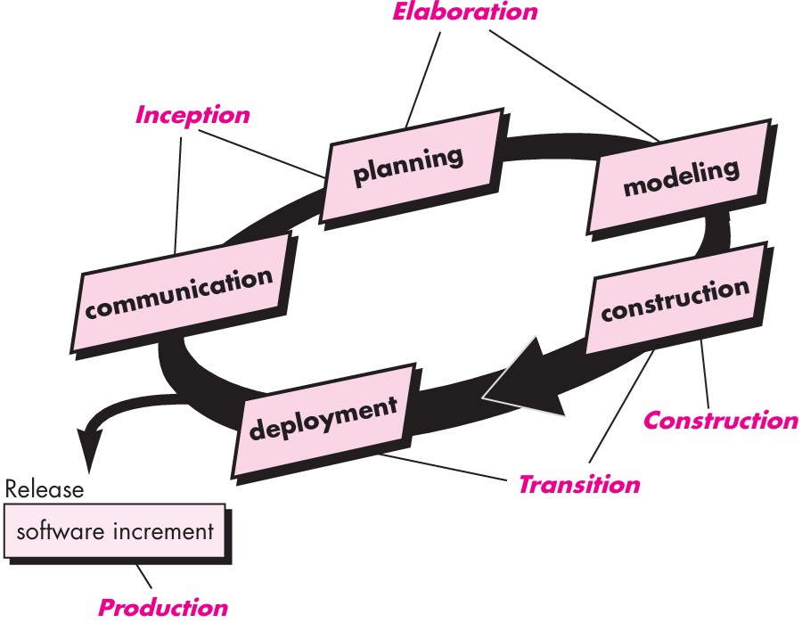

Slide 32
Personal and Team Process Models
The best software process is one that is close to the people who will be doing the work.
If a software process model has been developed at a corporate or organizational level, it can be effective only if it is amenable to significant adaptation to meet the needs of the project team that is actually doing software engineering work.
In an ideal setting, you would create a process that best fits your needs, and at the same time, meets the broader needs of the team and the organization.

Slide 33
Alternatively, the team itself can create its own process, and at the same time meet the narrower needs of individuals and the broader needs of the organization.
It is possible to create a “personal software process” and/or a “team software process.”
Both require hard work, training, and coordination, but both are achievable.

Slide 34
